Slide 1
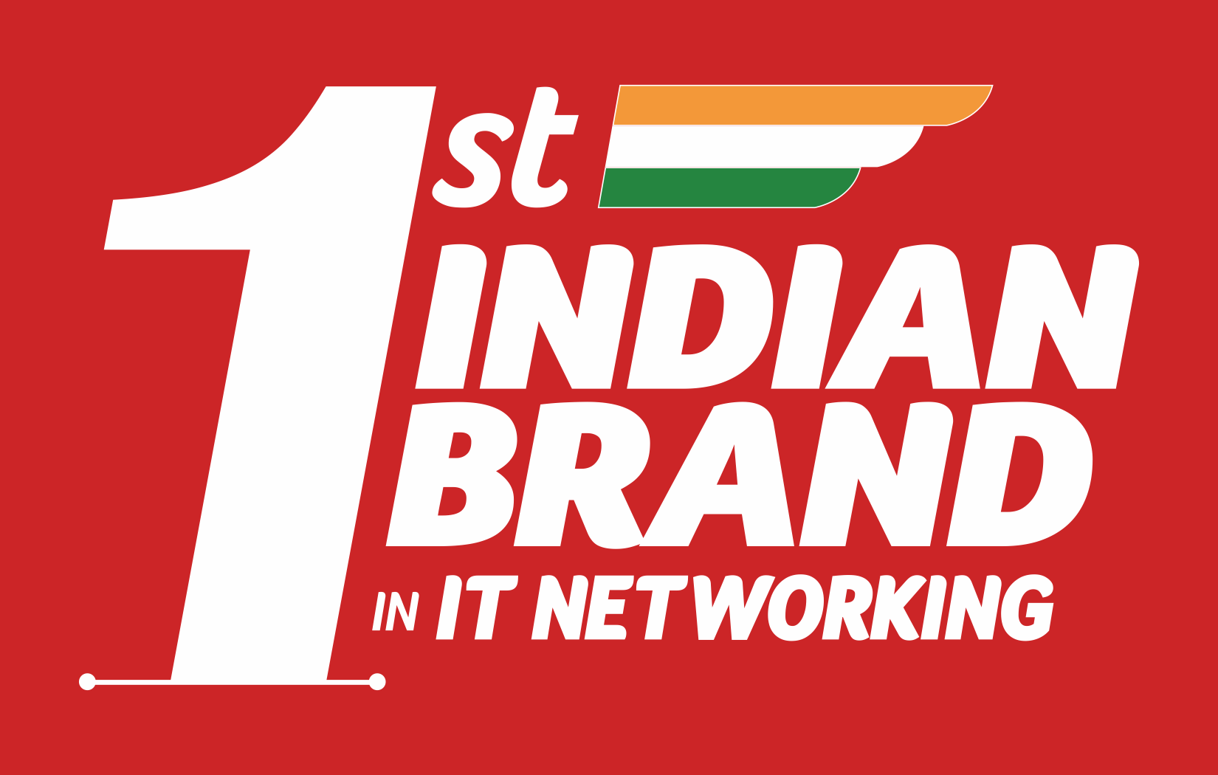

Slide 2
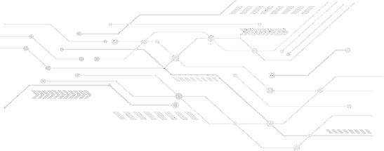
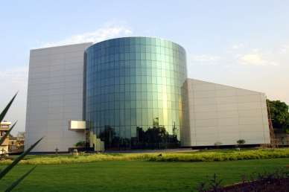
SMARTLINK HOLDINGS LTD.
SmartLink is a BSE | NSE listed company with the expertise of IT networking products marketing.
Smartlink Holdings Ltd., earlier known as Smartlink Network Systems Ltd., is one of India’s leading IT Networking Products Manufacturing Company for more than 3 decades. It was
established in the year 1993 to prop the Indian market in the field of network infrastructure. Pioneer in the field of Active and Passive Networking products.
Smartlink has a rich history of making many product brands reach the desired heights in the Indian and International markets. Smartlink now is an NBFC company, with its operations split into 2 wholly-owned subsidiaries to have a focused business approach.
SYNEGRA EMS Company, where all Active and passive Products are manufactured to supply EMS and ODM products to brand companies.
DIGISOL SYSTEMS Ltd., the Brand products company.
1986
1990
1993
1997
2000
2009
Manufacturing
Personal Computers
Distribution of
Networking Products
Manufacturing of Networking Products
Manufacturing of Cabling Products
Joint ventures with International brands
Launched DIGISOL

Slide 3
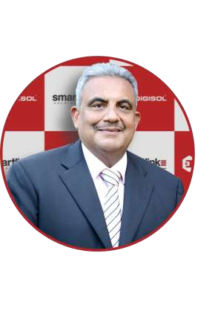
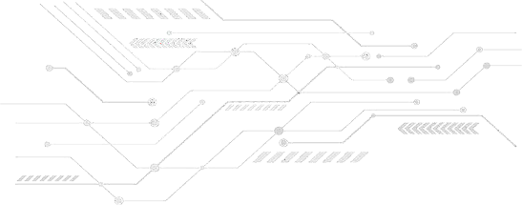
OUR FOUNDER
Mr. K. R. Naik is an IT networking industry veteran with experience of close to five decades
Two decades back he was recognized as the Father of India's IT Networking Industry due to his pioneering spirit in Manufacturing Networking Products in India.
He is credited for giving India its first indigenous IT Networking Products manufacturing company – SMARTLINK, which has been a local manufacturing success story for over three decades.
He has been instrumental in introducing Channel Distribution of products of well- known global IT Enterprise Products brands Cisco & Foundry. He had joint ventures in manufacturing products locally with D-Link Corporation in Networking Products, GIGABYTE for motherboards, LANNER for Industrial IT Products and SAPPHIRE UK for SCS products.
He also played a key role in creating the Channel Distribution in IT Networking Products market and developing the Channel Ecosystem in India.
DIGISOL is the brainchild of Mr. K. R. Naik

Slide 4
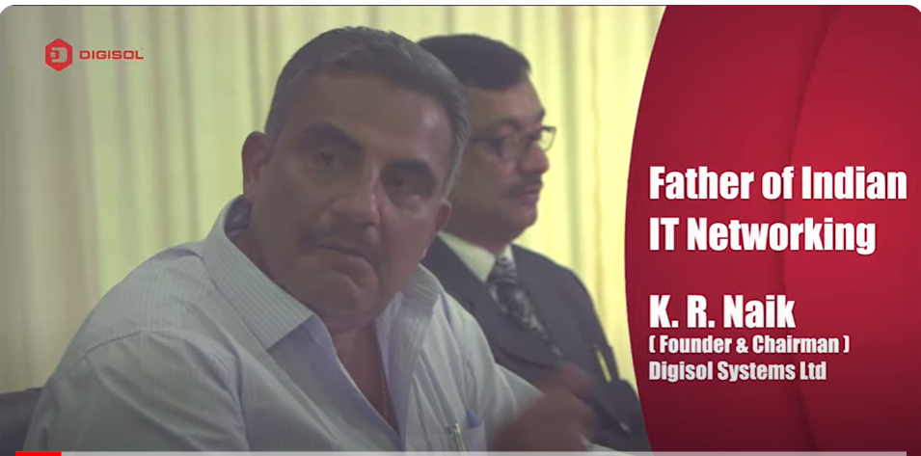
WE ARE…
One of the leading providers of IT Networking
Solutions.
We, at DIGISOL, innovate and offer top-notch end-to-end IT networking products and solutions from top ODM vendors worldwide.
DIGISOL’s offering includes FTTH Solutions (Fiber To The Home), Wireless (Wi-Fi) Solutions, Switching Solutions, and Structured Cabling in
Copper & Fiber.
DIGISOL is committed to the government’s vision for Vocal for Local and has been spearheading the government's “Make In India” initiative through its Made In India products and solutions.
https://youtu.be/O0sE_XWvFcU

Slide 5
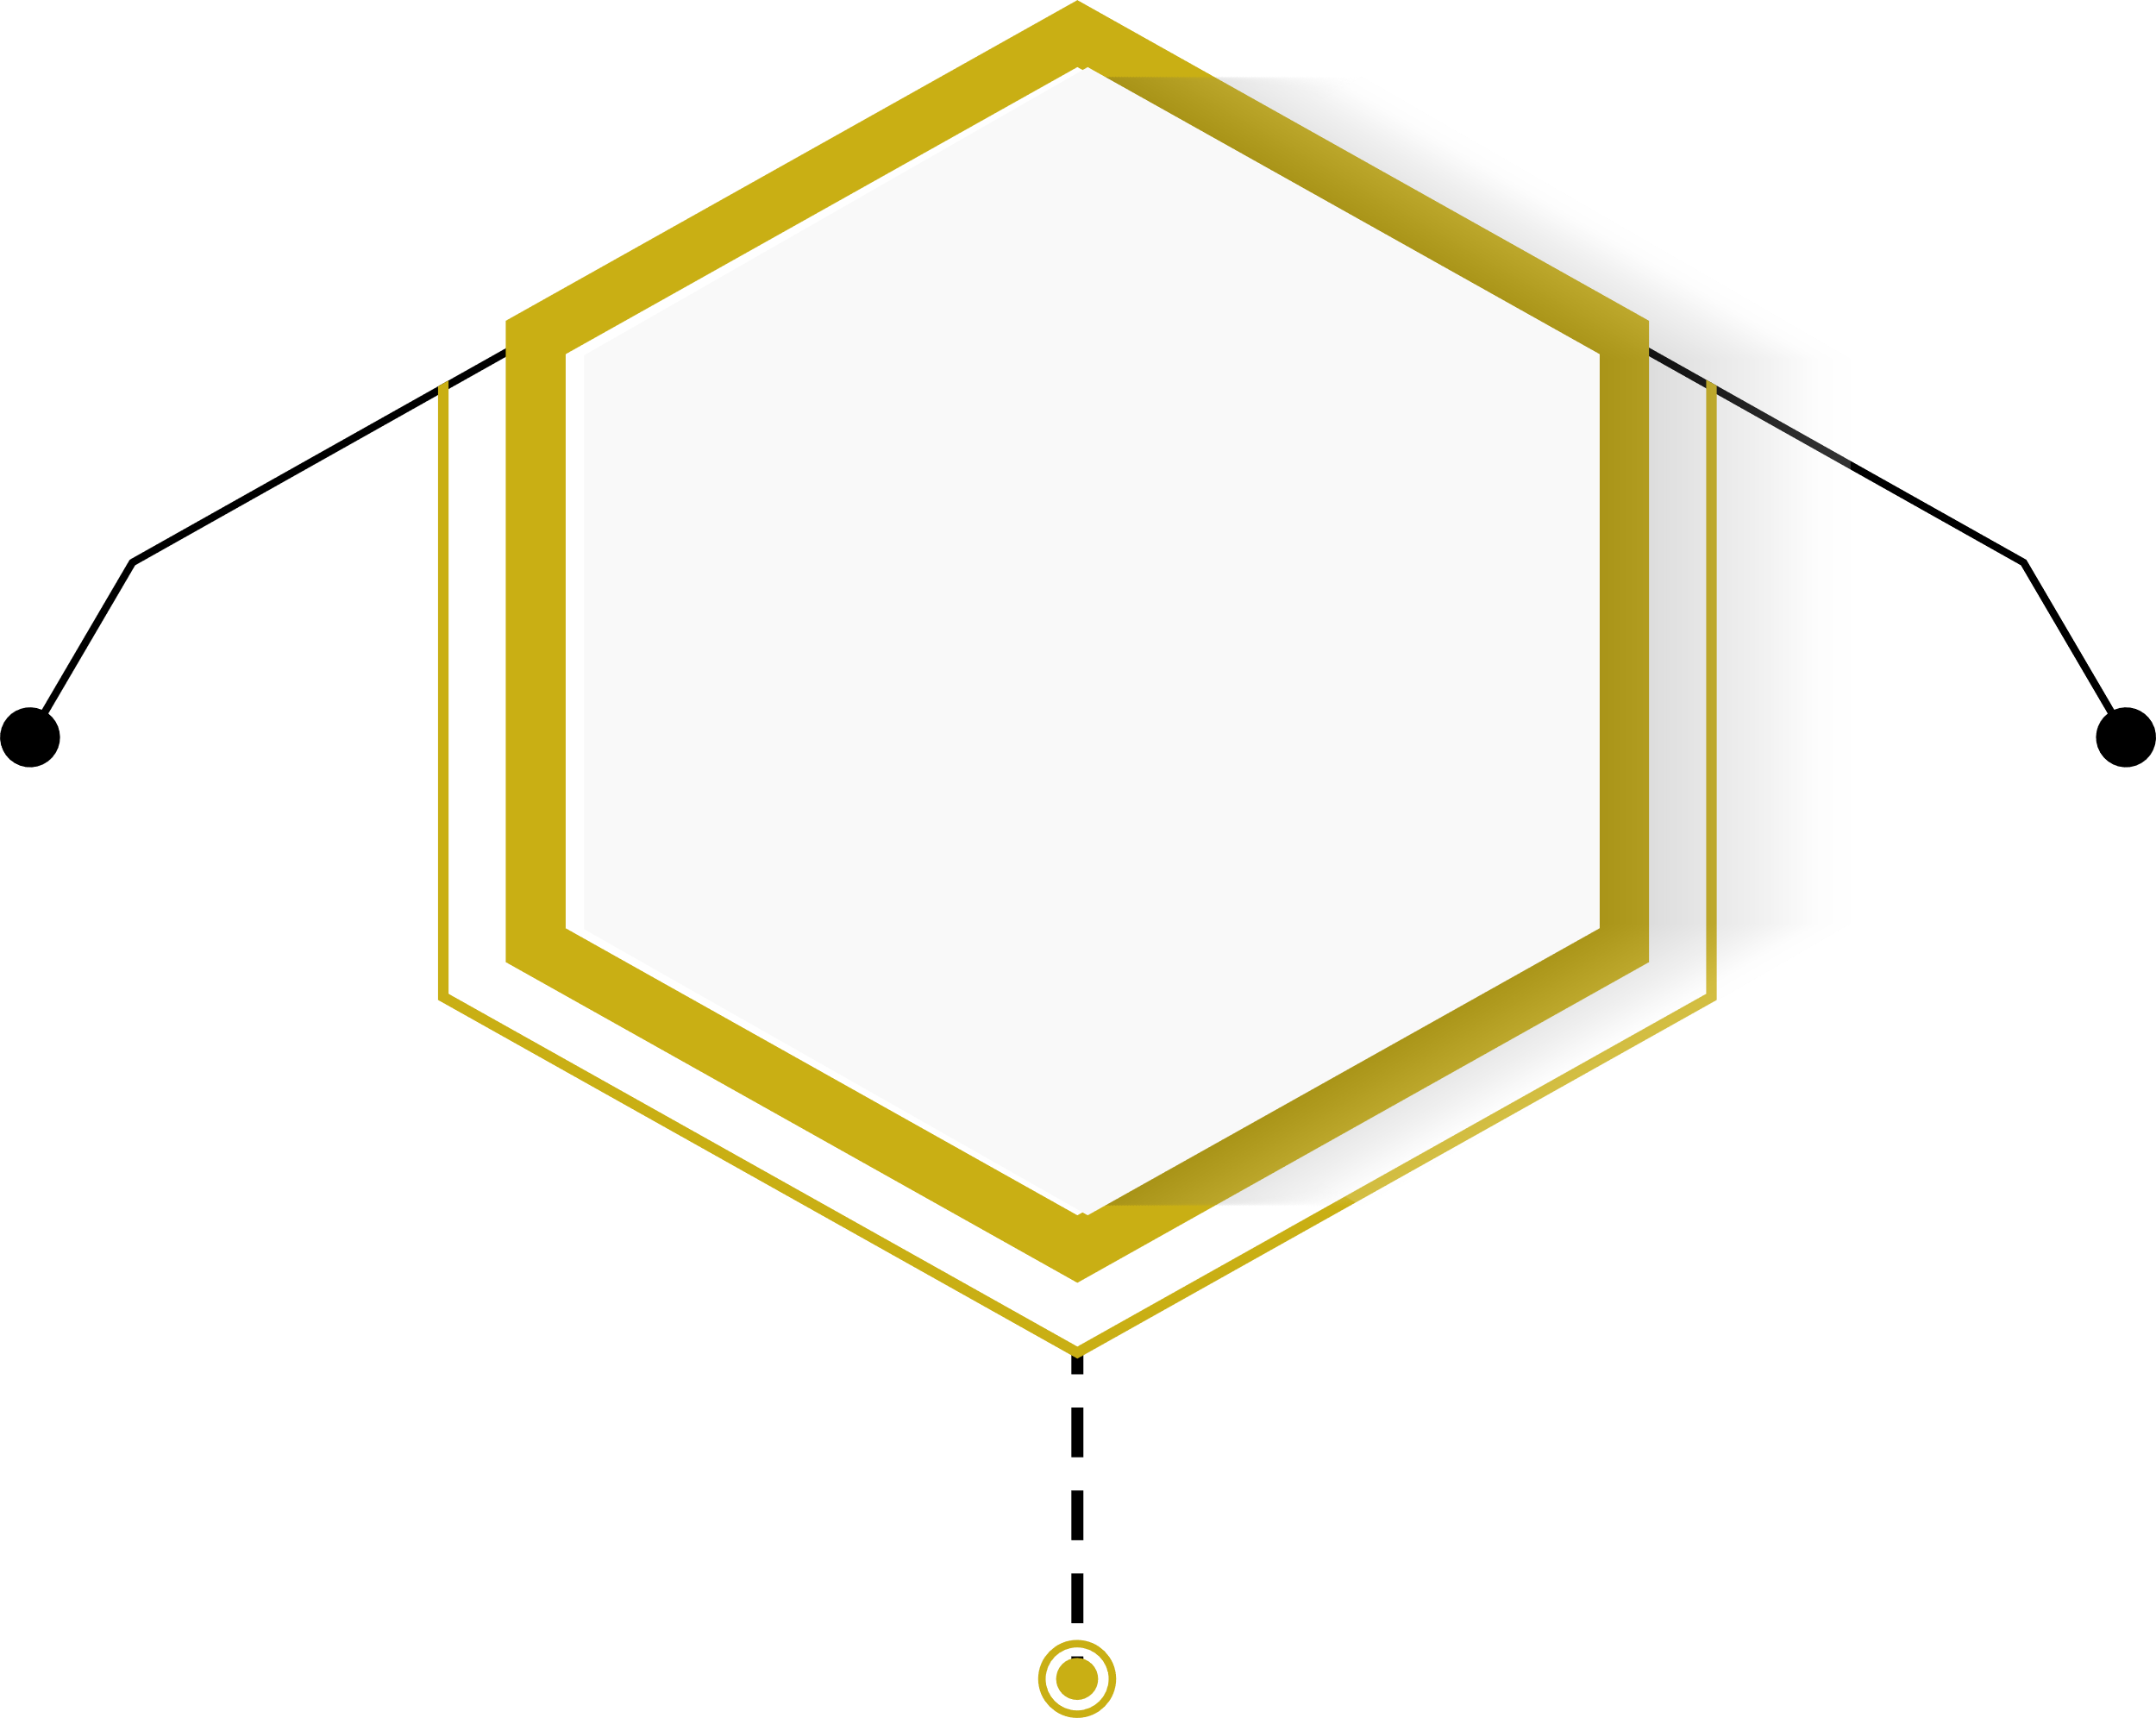
VALUES
MISSION
Highest Ethics
Being a provider of innovative solutions with a dedication to enhancing the IT networking experience of our customers
Creating a healthy, competitive as well as reliable environment for profitable business growth
Offering opportunities to all the stakeholders to grow to their full potential and contribute positively to the ecosystem
Integrity
Commitment
Innovation
People Growth
Customer Delight
VISION
To Become The Most Admired IT Networking Brand

Slide 6
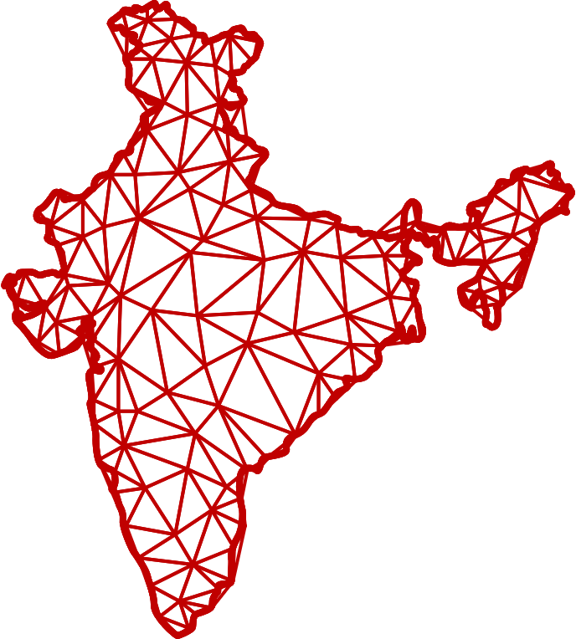
WHY DIGISOL
25 Years Of Experience In IT Networking Industry
End to End IT Networking solutions
PAN India Presence
Trusted Made In India
Commitment To Quality
Excellent Customer Service Support

Slide 7
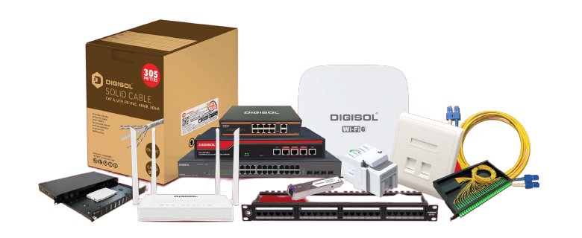
DIGISOL SYSTEMS LTD. is a First Indian brand in IT Networking
The parent company Smartlink Holdings Ltd. was into manufacturing of IT networking products even before the Make in India Scheme of 2014.
DIGISOL, one of its subsidiaries is responsible for marketing, distributing, and servicing networking products in India.
The company offers a wide range of IT networking products including FTTH, Switching, Wireless and Structured Cabling Solutions (copper and fiber), & is well-regarded as First Indian Brand in IT Networking Industry.
DIGISOL credit their workforce for the success in development, sales, marketing, and service support.
The company is experiencing significant growth and achieving remarkable milestones.
FTTH | WIRELESS (Wi-Fi) | SWITCHING | STRUCTURED CABLING (COPPER & FIBER)

Slide 8
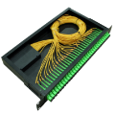
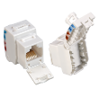
OUR OFFERINGS
DIGISOL offers complete End-To-End Networking Solutions, which include Active Networking and Passive Networking Solutions
ACTIVE NETWORKING
STRUCTURED CABLING
( PASSIVE NETWORKING )
DIGISOL PRODUCT RANGE
SWITCHING SOLUTIONS
WIRELESS SOLUTIONS
FTTH SOLUTIONS
COPPER CABLING
FIBER CABLING
FTTH CABLING

Slide 9
DIGISOL NETWORKING SOLUTIONS PORTFOLIO
ACTIVE
ACTIVE AND PASSIVE
PASSIVE
Controller Based Managed Wireless
SOHO Wireless
Copper
Fiber
Fiber to the Home
(FTTH)
Fiber to the Home
(FTTH)
Industrial Switching
Ethernet Switching
USP
Patented products
Environment-friendly solderless solutions with 30 micron gold plating
Products designed for Enterprise POE Application
Products rated as best Performers by 3rd party test labs
USP
USP
USP
Wide Temperature Range support for Industrial Switches
A complete range of FTTH solution comprising of Structured Cabling and Active Networking products
A complete range of FTTH solution comprising of Structured Cabling and Active Networking products
Redundant Power Supply for Aggregation Switches & OLT's
IPv6 support for Switches & OLT's
Dual Mode Xpon support for ONU's
EMS for OLT management

Slide 10
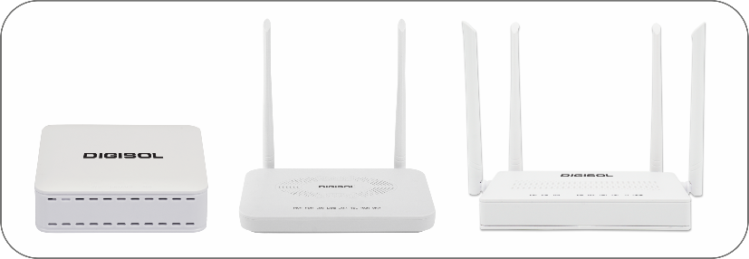
FTTH SOLUTIONS
• XPON ONUs
• GPON OLTs
• GEPON OLTs
• PON TRANSCEIVERS
Our End-to-End FTTH Solutions serve today's smart offices & home demand to enable smart technologies like Fiber-To-The-Home (FTTH), highspeed internet, triple-play service, Voice & Video for home-connected users. We offer hybrid solutions to enable seamless integration into the Internet of Things (IoT) capabilities.

Slide 11
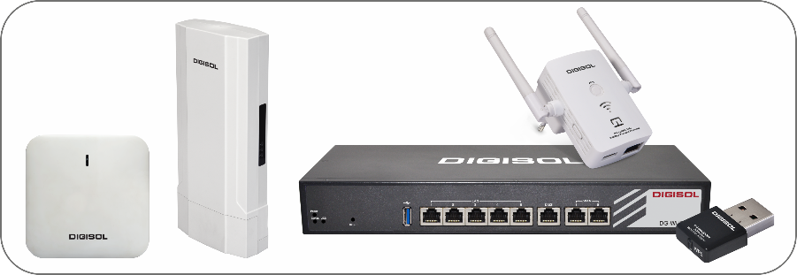
WIRELESS (Wi-Fi) SOLUTIONS
• Indoor Access Points
• Outdoor Access Points
• Controllers
• USB Adapters
• Repeater
Digisol wireless solution is perfect for businesses of all sizes demanding a simple, reliable, and accessible wireless network solution providing highspeed data and a seamless user experience. Our wireless services ensure high-speed data network coverage and provide seamless integration into networking services.

Slide 12
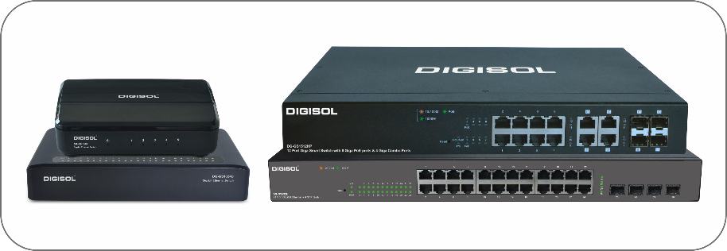
SWITCHING SOLUTIONS
• Fully managed
• Smart managed
• Unmanaged
• Chassis
Digisol delivers a complete package of switching solutions for Enterprise Networks, Data Centres, Small and Mid-size businesses. We provide Smart PoE Managed, Fully Managed, Chassis & Unmanaged switches. Our Switching Solutions offers include a wide range of Industrial Switches & Transceiver solutions.

Slide 13
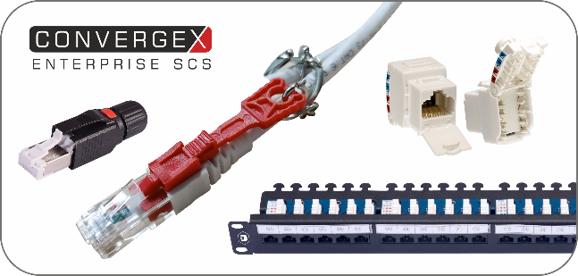
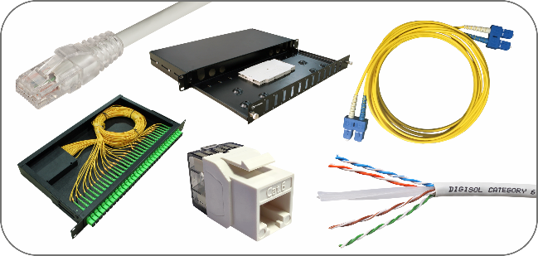
STRUCTURED CABLING (COPPER & FIBER)
ENTERPRISE STRUCTURED CABLING SYSTEMS
COPPER: CAT 6 and CAT 6A Solid Cables, Keystones, Patch Panels, Patch Cords, PoE Solutions, Industrial Field Plugs
CHANNEL STRUCTURED CABLING SYSTEMS
• COPPER: CAT 5E, CAT 6 and CAT 6A Solid Cables, Keystones, Patch Panels, Patch Cords, Face Plates, Tools, Rj45 Plugs and Surface Mount Box
• FIBER: Cables, Patch Cords, Pigtails, LIUs and Adapters
• FTTH: Cable, Splitters, FDBs, Home Termination Box and ODFs.

Slide 14
CERTIFICATIONS
AFFILIATION

Slide 15
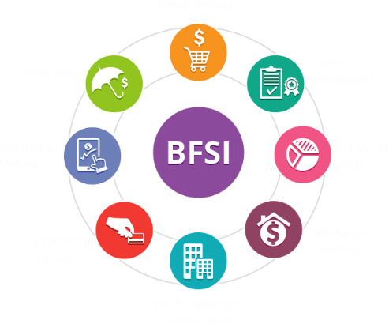
DIGISOL’S FOCUSED VERTICALS
Government
Smart Cities
Healthcare
Data Centers/ IT/ITES
Education
Telecom
Construction
& Power
BFSI

Slide 16
CUSTOMER SERVICE & SUPPORT
DIGISOL offers first-rate integrated after-sale-service and support, which consists of
Service Centers
DIGISOL Technical Assistance Centre (DTAC)
DIGISOL has efficient and highly skilled professionals that offer excellent state-of-the-art services to the customers
DIGISOL has a widespread network of 63 Service centres across India
Customers can connect to us for any query
Toll Free Number: 1800 – 209 – 3444
Email: helpdesk@digisol.com

Slide 17
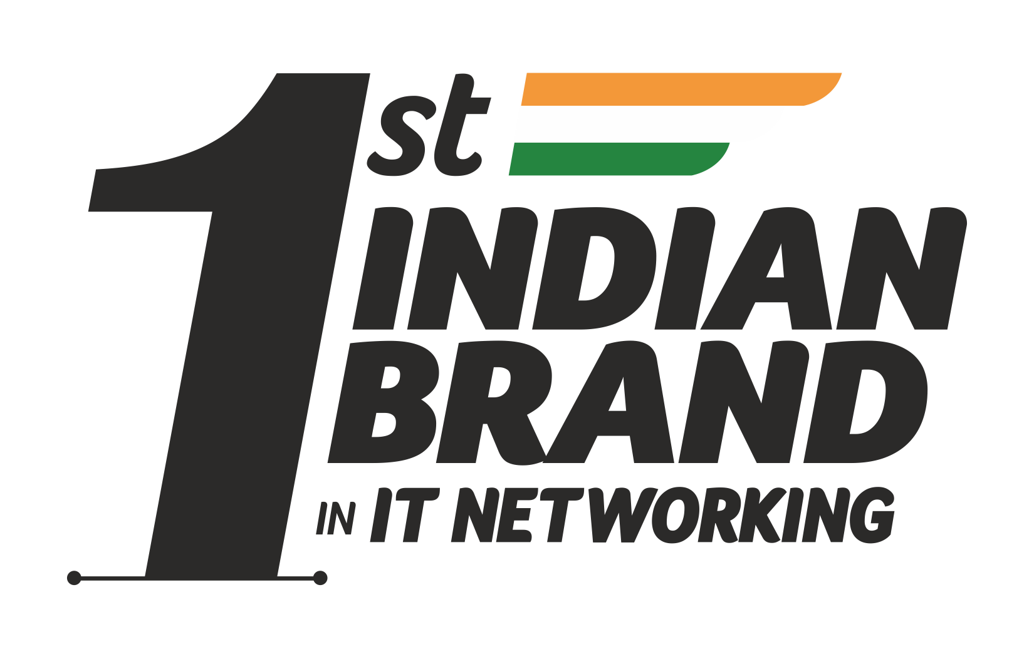
OUR PRESENCE
Our unique distribution system comprises of exclusive regional distributors to address the SOHO, SMB and SME segments.
This ensures extensive reach and easy availability of all our products and solutions throughout the country.
10 Branch offices
Sales Presence in 50 cities
63 Service & Support
Centers
In house Level 4 Support

Slide 18
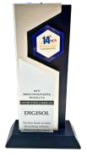
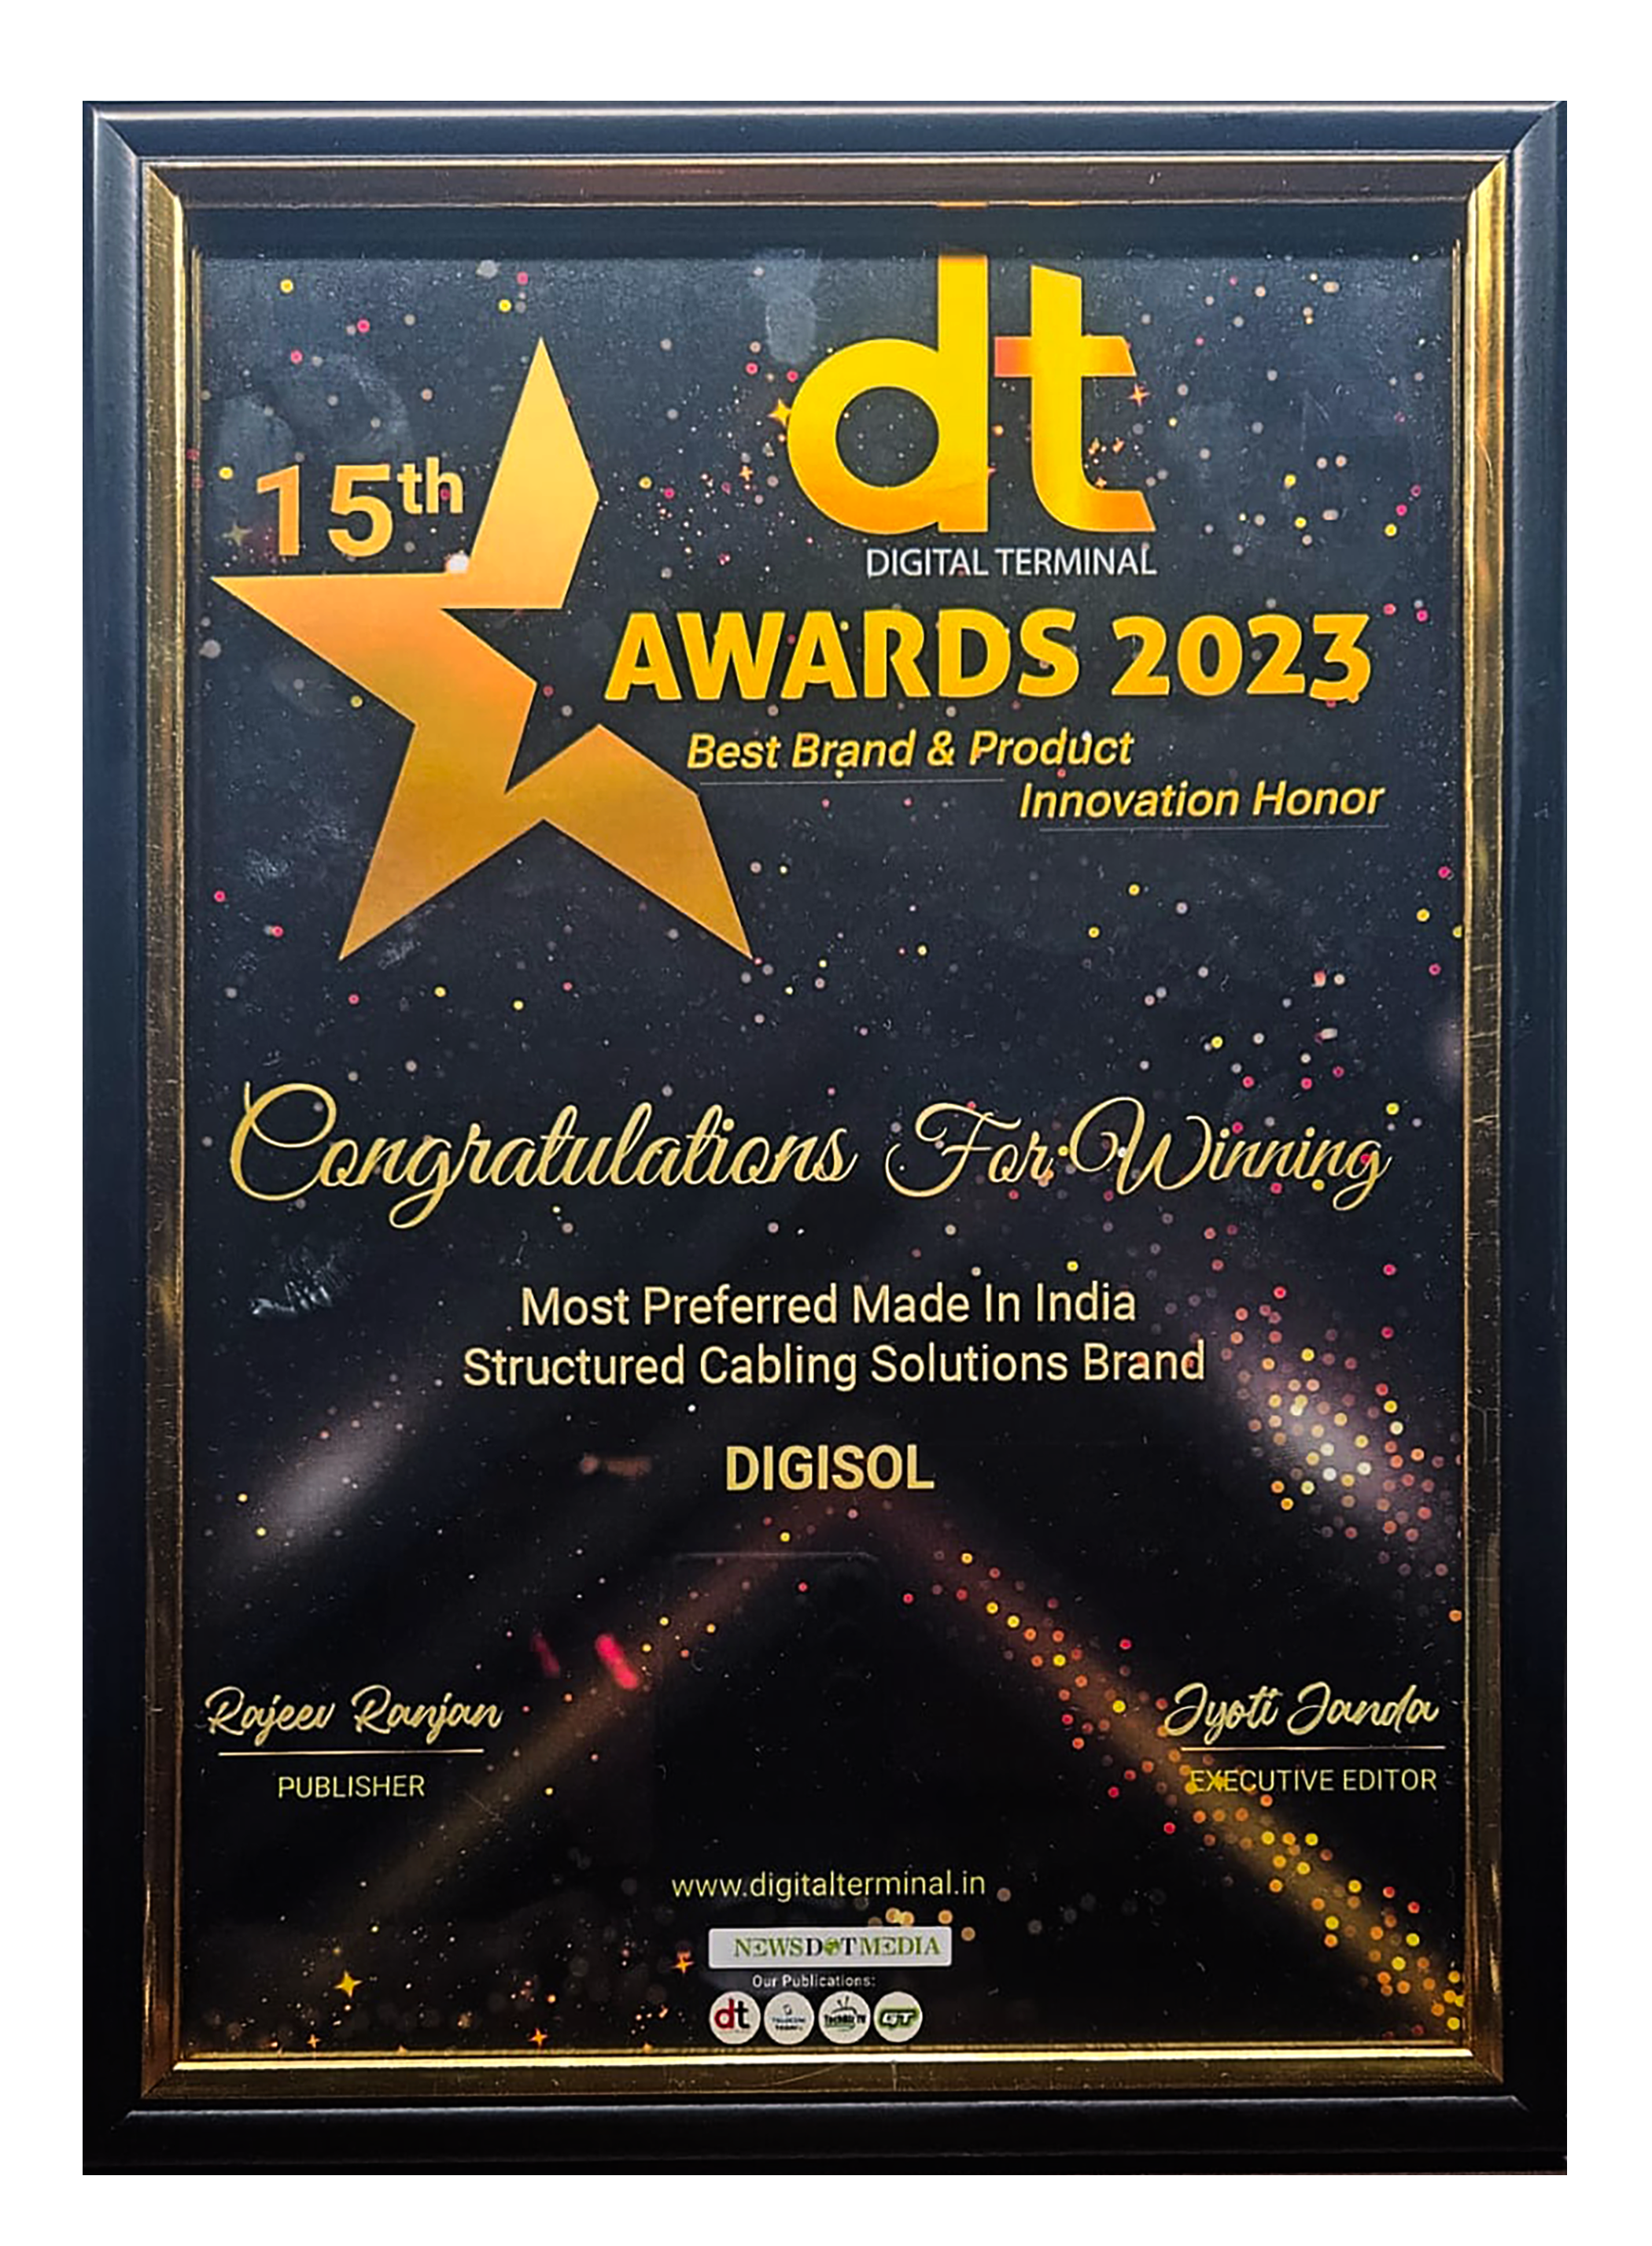
Awards
India’s Fastest Growing Next-Generation FTTH Solutions Brand & Most Preferred Made in India Structured Cabling Solutions Brand at the 15th DT Awards 2023
“Leading Make in India Manufacturer of 2022 & “The Best Made in India Manufacturer of Networking Solutions Brand of 2022 at the NCN ICT India Summit
“The Exemplary Made In India FTTH Brand of 2021” & “The Best Made In India Networking Solution Brand Of 2021” at the 14th NCN Innovative Products Award 2021.
“Best Structured Cabling Brand of India 2022" & "Best Made in India FTTH Product Brand 2022” at Digital Edge Enterprise Channels Summit & Awards 2022
“Best Structured Cabling Solution Provider Of The Year” at NSS Solution Providers Awards 2018
“Structured Cabling Innovation Of The Year” at the Ninth SME CHANNELS Summit and Awards 2018
“Best Make In India Wi-Fi Company” at My India Wi-Fi India Summit & Awards 2017
"Best Quality Structured Cabling Brand" at DT Awards 2017
“Networking Product Brand In Make In India” at SME Channel Award 2016
“Most Popular Networking Brand” at NCN Awards 2016

Slide 19
Value Addition
In a bid to empower partners, Digisol introduced a new certification and training institution DITT- Digisol Institution of Technical Training for Partners & System Integrators across India. The institution aims to create value for all our Network Engineers, Channel Partners and ISPs by consistently delivering quality training programs which are always in sync with the market demands.
DIGISOL INSTITUTE OF TECHNICAL TRAINING
https://ditt.digisol.com/

Slide 20
Value Addition
Digisol Cash Karo is a Loyalty Program designed to reward the loyal customers of Digisol from the Indian Electrician & Retailer community.
It's a platform that helps Electricians & Retailers to win cash back and here's how- Electricians and Retailers can download the app, scan the QR Code available on the product package and collect points.
These points are further converted into cash and are transferred to the electrician's bank account. Additionally, electricians can available the bonus points, schemes and offers introduced by Digisol from time to time!
DIGISOL CASH KARO LOYALTY PROGRAM
https://cashkaro.digisol.com/

Slide 21
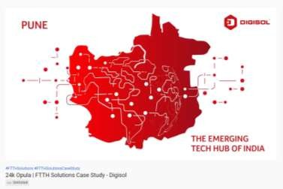
KEY CASE STUDIES
Over the years Digisol has been associated with various projects and those successful case studies has been uploaded on our YouTube page for your reference- https://www.youtube.com/channel/UCMsB9RqkGF8NCZDty4r2R-g
Some of the Case Studies are mentioned
below:
Sindhudurg Police Station
24k Opula
Healthcare Case study
The Fern Leo Resort
Research Designs & Standards Organization

Slide 22
THE DIGISOL OFFERINGS ARE HERE TO UPGRADE

Slide 23
VALUED CUSTOMER
Indian Air Force
Hindustan Petroleum Corporation Limited
TELANGANA STATE TECHNOLOGY
MANTRALAYA MUMBAI
TELANGANA STATE TECHNOLOGY
U R Rao Satellite Centre
MANTRALAYA MUMBAI
Hindustan Aeronautics Limited
Karnataka Legislative Assembly

Slide 24
VALUED CUSTOMER
Ahmedabad Metro
Mumbai Metro
Defence Research and Development Organisation
TELANGANA STATE TECHNOLOGY
Indian Navy
MANTRALAYA MUMBAI
TELANGANA STATE TECHNOLOGY
MANTRALAYA MUMBAI
Bengaluru Metro Rail Corporation Limited
National Aerospace Laboratories
Indian Army

Slide 25
CUSTOMERS - VERTICAL WISE
Government/PSU
Hindustan Aeronautics Limited
Indian Air Force
ELECTRONIC CORPORATION OF INDIA LIMITED, ECIL
Defence Research and Development Organisation
Indian Navy
MANTRALAYA MUMBAI
TELANGANA STATE TECHNOLOGY
U R Rao Satellite Centre
Hindustan Petroleum Corporation Limited
National Aerospace Laboratories
URBAN DEVELOPMENT & MUNICIPAL
AFFAIRS DEPARTMENT, GOVT. OF WB
Karnataka Legislative Assembly
Indian Army

Slide 26
CUSTOMERS - VERTICAL WISE
BFSI
Smart Cities
AGARTALA SMART CITY
Varanasi Smart City
Bhopal Smart City
Aurangabad Smart City
Raipur Smart City
Tumakuru Smart City
Rajkot Smart City
Dahod Ssmart City

Slide 27
CUSTOMERS - VERTICAL WISE
Education
Telecom
Tata Institute Of Fundamental
Research
JOISTER
Iit Roorkee
IIT Mandi
Jai Hind College,
Mumbai
Christ University, Bangalore
Mumbai University
Sattava Knowledge City, Hitech City, Hyderabad
BHARTI AIRTEL
DVOIS SSV
GTPL BROADBAND PVT. LTD
GOA INSTITUTE OF MANAGEMENT
GOA UNIVERSITY
YOU BROADBAND
(VODAFONE)

Slide 28
CUSTOMERS - VERTICAL WISE
Healthcare
Construction & Power
Baramati Hospital
Christ University, Bangalore
GTPL BROADBAND PVT. LTD
SUASTH HOSPITAL
Sunteck
Acropolis, Pune
MAA ENT HOSPITAL
TATA POWER DELHI DISTRIBUTION LIMITED
DELTA GARDEN, MUMBAI
Shah Group's HYDE PARK, PUNE

Slide 29
CUSTOMERS - VERTICAL WISE
Infrastructure
Data Center
Ahmedabad Metro
Mumbai Metro
PANAGARH DEFENCE AIRPORT
Kolkata Metro
Bengaluru Metro Rail Corporation Limited
Christ University, Bangalore

Slide 30
DIGISOL CONTACT DETAILS
THANK YOU
Mr. Samir Kamat
+91 9819245607
Samir.kamat@digisol.com
Mr. Shridhar Kadam
+91 9987222354
Shridhar.kadam@digisol.com
Mr. Dinesh Thakur
+91 9987222355
Dinesh.thakur@digisol.com
DIGISOL SYSTEMS LTD
CITIPOINT, 7th Floor, Unit No. B-701, Andheri - Kurla Rd, Andheri East,
Mumbai, Maharashtra 400059

